Slide 1




This week in CS 60
HW Reminders:
Intelligent Spam Gathering!
HW 5 due Monday, 2/28 @ 11:59 pm
Enqueue, Dequeue, Queue, and Deque
¿Que?
Java interfaces: ensuring the rights of all classes…
and conferring responsibilities pertaining thereto
Linked lists and AI: a connection of depth or breadth?
Notes:
I don’t know if this really works...

Slide 2
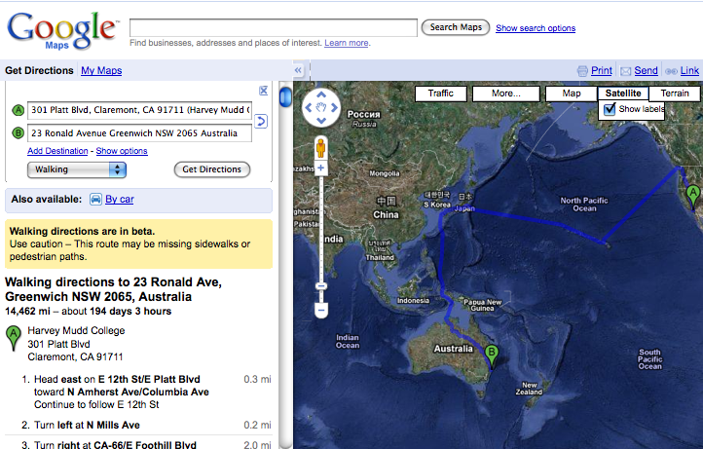
Direction Finding!

Slide 3
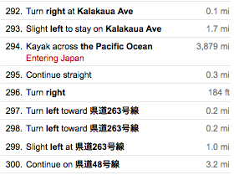
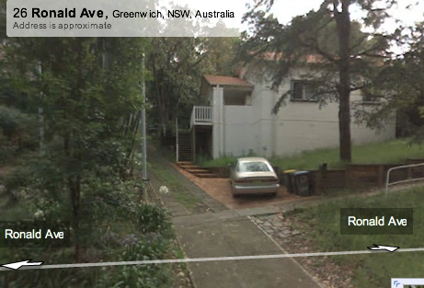

Slide 4
Search for Spam!
This maze looks kinda easy to me…
Notes:
I don’t know if this really works...

Slide 5
A
Data Structure Shop
Linked List
D
T
A
Array A
42
7
-3
0
1
2
Many ways of structuring data (lists, lists of lists, etc.)
2d array M
a
b
c
A
B
C
reminder about java arrays…

Slide 6
A
Data Structure Shop
Linked List
D
T
A
Array A
Object[] A = new Object[3];
// user inputs some data into A
for (int i=0 ; i<A.length ; ++i)
// access each element, A[i]
System.out.println( A[i] );
1d arrays
42
7
-3
0
1
2
what would this print?!
2d array M
Object[][] M = new Object[2][3];
// how to access each element of M?
2d arrays
a
b
c
A
B
C

Slide 7
Information Structure Showroom...
Features!
in
out
enqueue
dequeue
isEmpty
Queue
42
7
…
60
Queue users will
expect this interface
in
push
pop
isEmpty
Stack
42
7
…
60
Stack users will
expect this interface
out
cons
append
isEmpty
OpenList
42
7
…
60
same interface as
Scheme's lists have
provides open access to the list
Notes:
real distinction here is open vs. closed!

Slide 8
Open vs. Closed Lists
Open
Closed
O
U
R
S
M
I
N
E
Y
An OpenList is a cell of an open list!
A Stack (or closed list) consists of StackCells.
Possible sharing of cells
No changing of [data, reference] pairs
Proprietary data (no sharing)
List can be changed destructively
Notes:
draw lines to show what is of what type!!
both sides…

Slide 9


Stacks: an Abstract Data Type
do a little example
push 1
push 2
push 3
int x = pop()?
“Last-In-First-Out” (LIFO)
supported operations:
  push( Object o )
  Object pop()
  boolean isEmpty()
  (also can include peek())
Add Data: Red
Remove Data: Blue
Key Concept: "ABSTRACT" means we
promise to fulfill a behavioral contract,
but the Stack user doesn't know how
Why don’t you need to specify which
element you want?

Slide 10
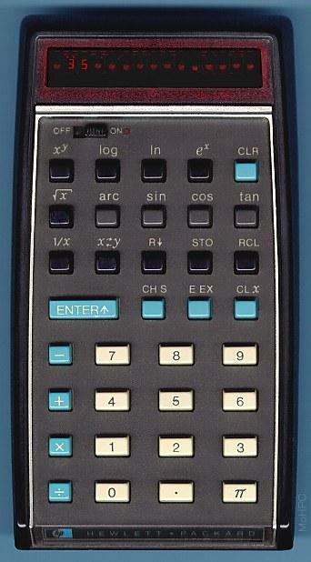
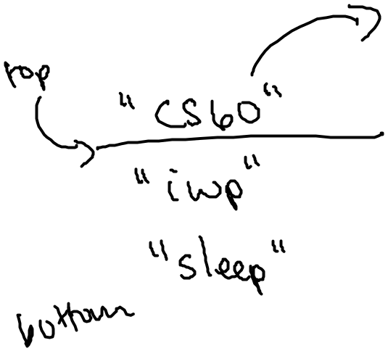
Stacks
Last In, First Out (LIFO)
public static void main(String[] arg)
{
Stack S = new Stack();
S.push(“sleep”);
S.push(“innertube waterpolo”);
S.push(“do CS 60 assignment!”);
System.out.println(S);
Object midnight = S.pop();
System.out.println(S);
}
push - inserts an item at the front
pop - removes the item at the front

Slide 11
A Stack interface (The contract)
/*
* StackInterface.java
*
* provides an interface for all of the funtions
* a Stack should implement
*
* If a class implements this interface, it can
* then be used as a Stack...
*/
interface StackInterface
{
public boolean isEmpty();
public Object peek();
public Object pop();
public void push(Object data);
public String toString();
}
No actual functions!?? Hey - can I write code like this… ?
in a file named StackInterface.java

Slide 12
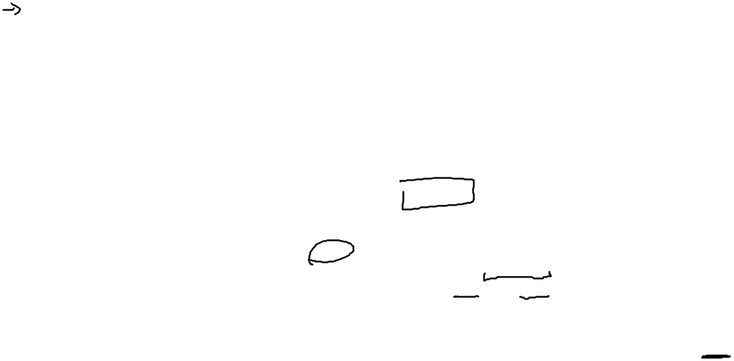
ADT = Many
possible
implementations
Stack S = new Stack();
S.push("Sleep");
S.push("IWP");
S.push("CS60");
S.push("Dinner!");
S.pop();
Stacks,
in pictures
with linked lists
after these 6 lines of code…
name: S
class: Stack
name: front
type: StackCell
name: ?
type: StackCell
name: ?
type: StackCell
n: data
t: Object
n: next
t: StackCell
n: data
t: Object
n: next
t: StackCell
n: data
t: Object
n: next
t: StackCell
"CS60"
"IWP"
"Sleep"
x
name: <none>
class: StackCell
n: data
t: Object
n: next
t: StackCell
"Dinner!"
we're stoked and stacked!

Slide 13
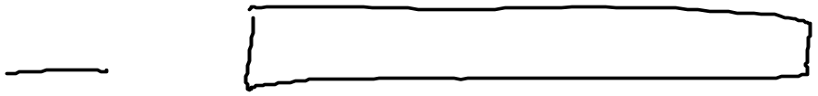
/* Our Stack class provides all of the methods that
* StackInterface requires us to have…
*/
class Stack implements StackInterface
{
/* StackCell is an inner class that Stack will
* use to wrap its data in a linked list */
class StackCell
{
private Object data;
private StackCell next;
private StackCell(Object data)
{
this.data = data;
this.next = null;
}
}
/* the one data member of each Stack object,
* the front of the stack (for pushing/popping)
*/
private StackCell front;
/* constructor - creates an empty stack
*/
public Stack()
{
front = null;
}
Stacks,
in code
This all looks sort of familiar…!
except maybe this…
All nulls are equal … but some nulls are more equal than others!
are these two nulls the same?

Slide 14
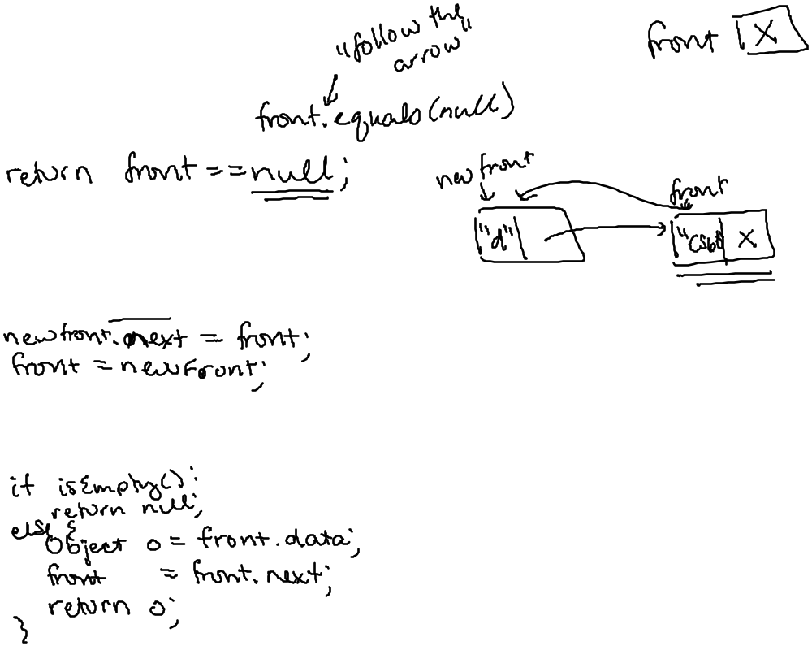
"Quiz"
Complete the linked-list implementation of a Stack.
class Stack implements StackInterface
{
// StackCell code and constructors here
public boolean isEmpty()
{
}
public void push(Object data)
{
// creates the new StackCell…
StackCell newFront = new StackCell(data);
}
public Object pop()
{
}
write isEmpty()
finish push(Object data)
write pop()
extra: toString()
public String toString()
{
}

Slide 15
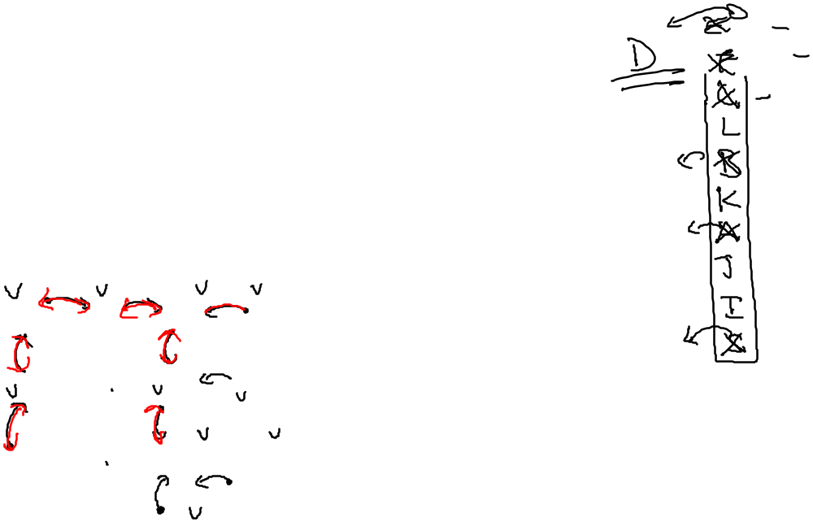
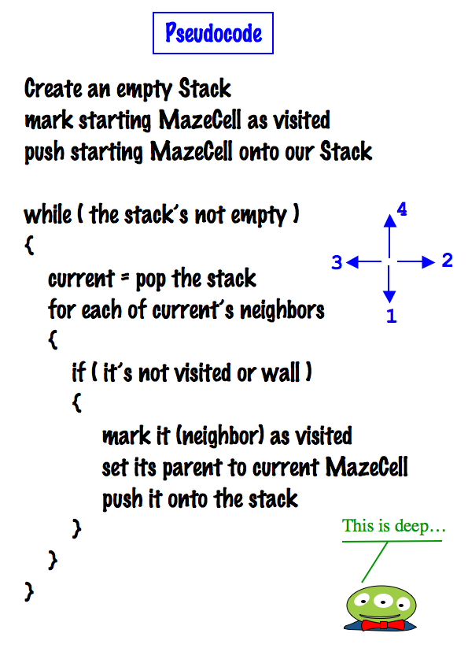
Depth-first search (DFS)
4
3
2
1
col
col
col
col
col
col
0
1
2
3
4
5
row
0
row
1
F
C
B
L
row
2
E
A
K
row
D
S
SEWN
3
J
row
4
G
H
I
row
5
‘S’ = Start Spam Seeking
‘D’ = Delectible Dinner Destination
Notes:
I don’t know if this really works...

Slide 16

Depth-first search (DFS)
col
col
col
col
col
col
0
1
2
3
4
5
row
0
row
1
F
C
B
L
row
2
A
1
E
K
4
2
row
D
S
NESW
3
J
3
row
4
G
H
I
row
5
‘S’ = Start Spam Seeking
‘D’ = Delectible Dinner Destination
Notes:
I don’t know if this really works...

Slide 17
Search for Spam!
What classes
do you need?
(Don't peek
ahead)
This maze looks kinda easy to me…
Notes:
I don’t know if this really works...

Slide 18
Search for Spam!
col
col
col
col
col
col
0
1
2
3
4
5
class MazeCell
{
private int row;
private int col;
private char contents;
private boolean visited;
private MazeCell parent;
MazeCell(int row, int col, char c)
{
this.row = row;
this.col = col;
this.contents = c;
this.visited = false;
this.parent = null;
}
public String toString()
{
return "[" + row + "," +
col + "," +
contents + "]";
}
}
row
0
row
1
row
2
row
3
row
4
row
5
Here are the available characters:
‘S’ = Start Spam Seeking
‘*’ = Wall!
‘D’ = Delectible Dinner Destination
‘ ’ = Open Space
Notes:
I don’t know if this really works...

Slide 19

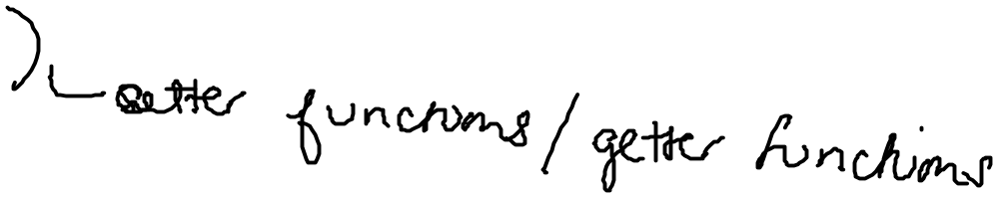
Privacy, Please
class MazeCell
{
private int row;
private int col;
private char contents;
private boolean visited;
private MazeCell parent;
MazeCell(int row, int col, char c)
{
this.row = row;
this.col = col;
this.contents = c;
this.visited = false;
this.parent = null;
}
public boolean isWall()
{ return this.contents == '*'; }
public String toString()
{
return "[" + row + "," +
col + "," +
contents + "]";
}
}
Only way to access
contents of the MazeCell
Here are the available characters:
‘S’ = Start Spam Seeking
‘*’ = Wall!
‘D’ = Delectible Dinner Destination
‘ ’ = Open Space
Notes:
I don’t know if this really works...

Slide 20
Bad Magic
class MazeCell
{
private int row;
private int col;
private char contents;
private boolean visited;
private MazeCell parent;
MazeCell(int row, int col, char c)
{
this.row = row;
this.col = col;
this.contents = c;
this.visited = false;
this.parent = null;
}
public boolean isWall()
{ return this.contents == '*'; }
public String toString()
{
return "[" + row + "," +
col + "," +
contents + "]";
}
}
Magic value
Here are the available characters:
‘S’ = Start Spam Seeking
‘*’ = Wall!
‘D’ = Delectible Dinner Destination
‘ ’ = Open Space
Notes:
I don’t know if this really works...

Slide 21
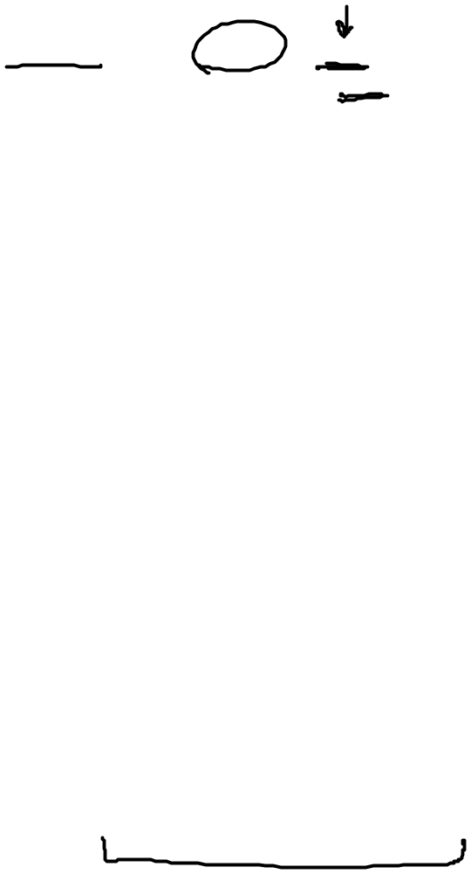
No More Magic!
class Maze
{
public static char WALL = '*';
public static char EMPTY = ' ';
public static char START = 'S';
public static char DESTINATION = 'D';
public static char FOOTSTEP = 'o';
class MazeCell
{
private int row;
private int col;
private char contents;
private boolean visited;
private MazeCell parent;
MazeCell(int row, int col, char c)
{
this.row = row;
this.col = col;
this.contents = c;
this.visited = false;
this.parent = null;
}
public boolean isWall()
{ return this.contents == WALL; }
MazeCell is an inner class.
It is defined inside the Maze
class and only accessible there
Notes:
I don’t know if this really works...

Slide 22
Stacks & Magic
implementing functions and recursion!
int L(int n)
{
if (n <= 1) return 0;
int a = L(n/2);
int result = a+1;
return result;
}
my head hurts!
my head hurts!
my head hurts!
What will the stack look like (at its largest point) if you call L(4) ?
What familiar function is L ?

Slide 23
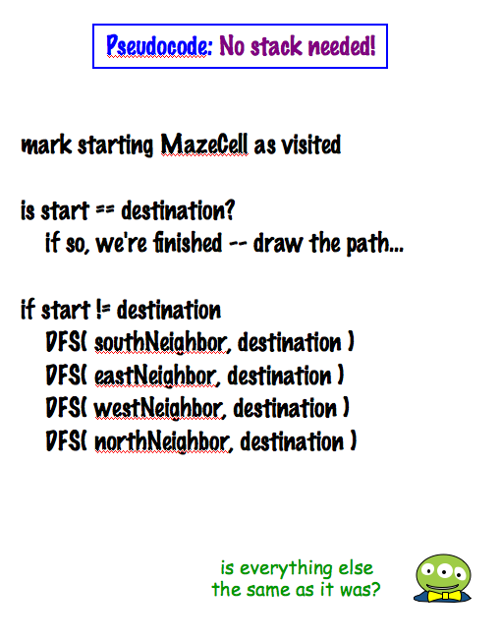
Recursive DFS
4
3
2
1
SEWN
D
S
Is everything the same as before?
‘S’ = Start Spam Seeking
‘D’ = Delectible Dinner Destination
No stack needed !!
(explicit)
Notes:
I don’t know if this really works...

Slide 24
Stack vs. Queue information structures
/*
* StackInterface
*/
interface StackInterface
{
public int pop();
public void push(Object data);
public boolean isEmpty();
// might want toString, too!
}
/*
* QueueInterface
*/
interface QueueInterface
{
public int dequeue();
public void enqueue(Object data);
public boolean isEmpty();
// might want toString, too!
}
in
in
out
42
42
7
…
60
7
…
60
out
Stack
Queue
How will switching to a Queue change our search procedure?

Slide 25
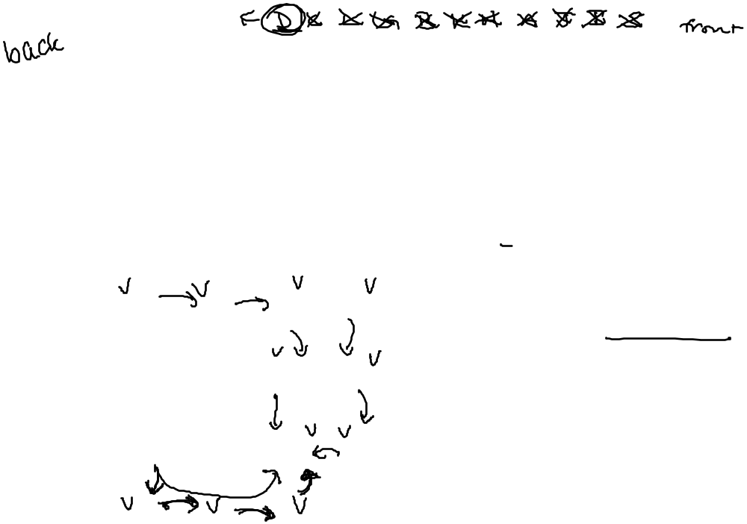
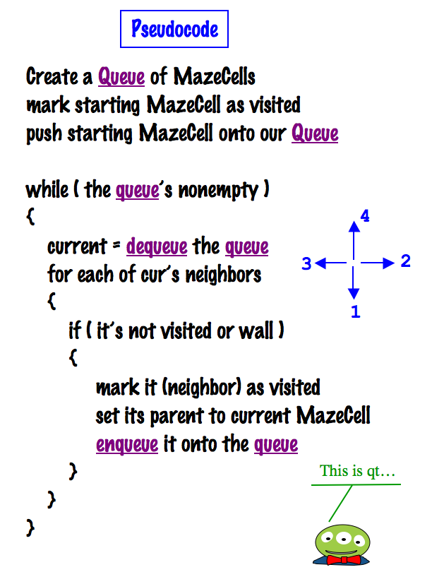
Breadth-first search (BFS)
4
3
2
is it really search at all?
1
col
col
col
col
col
col
0
1
2
3
4
5
row
0
row
1
F
C
B
L
row
2
E
A
K
row
D
S
3
J
row
4
G
H
I
row
5
‘S’ = Start Spam Seeking
‘D’ = Delectible Dinner Destination
Notes:
I don’t know if this really works...

Slide 26
Amazed by details?
col
col
col
col
col
col
class Maze
{
// inner class MazeCell contains
// row, col, contents, parent, visited
private MazeCell[][] maze;
public Maze(String filename)
{
this.maze = null;
// check out this function for details
// on reading text from a file in Java
this.loadMazeFromFile(filename);
}
public MazeCell findMazeCell(char ch)
{
for (int r = 0; r<maze.length; r++)
for (int c = 0; c<maze[r].length; c++)
if (maze[r][c].contents == ch)
return maze[r][c];
return null; // not there!!
}
public BFS(MazeCell start, MazeCell destination)
{
// to be written in hw5!
}
0
1
2
3
4
5
row
0
row
'D'
1
row
2
row
'S'
3
row
4
row
5
Hw5, part 2: implement breadth-first search
Notes:
I don’t know if this really works...

